Slide 1
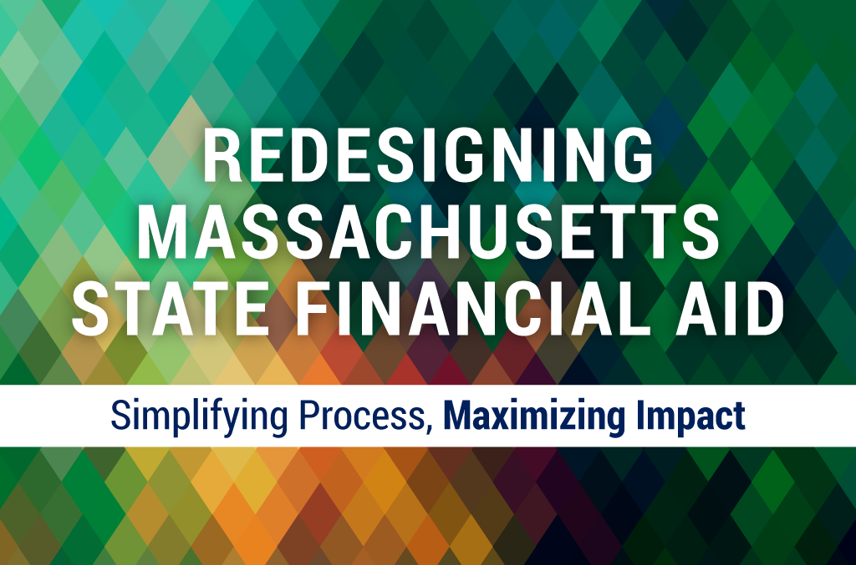
Board of Higher Education Meeting | May 1, 2018

Slide 2
Background
Redesigning Massachusetts State Financial Aid
Massachusetts Student Financial Aid Study
Initiated by the “Redesigning State Aid in New England” Project, supported by the New England Board of Higher Education and funded by The Lumina Foundation
Consultants from Harvard Graduate School of Education:
Professor Bridget Terry Long, Ph.D.
Monnica Chan, Ph.D. Candidate
Study produced a set of recommendations for reforming / consolidating state financial aid to move the Commonwealth forward on DHE’s “Big Three” Priority Objectives:
Making college more accessible and affordable for all Massachusetts residents
Closing gaps in student opportunity and achievement
Improving college completion rates

Slide 3
Study Overview
Redesigning Massachusetts State Financial Aid
BHE presentation in March—Dr. Long and Ms. Chan offered overview of the scope/results of their study:
Analysis of the extent to which current financial aid programs are meeting residents’ needs
Identification of opportunities to create efficiencies
Identification of opportunities to simplify the aid process for families
Forecast of future state financial aid needs, projected demographics/socioeconomic changes

Slide 4
Summary of Study Recommendations
Redesigning Massachusetts State Financial Aid
Five overarching recommendations for improving effectiveness and efficiency of current state aid system:
Address the substantial unmet financial need facing many students and families
Consolidate programs with similar goals into a simpler, more streamlined system to benefit multiple stakeholders
Repackage the Massachusetts system of tuition waivers into a simplified, well-publicized grant program
Apply lessons learned and innovations from pilot programs to existing aid policies
Improve communications regarding state financial aid programs for clarity and increased awareness

Slide 5
Recommendations & Action Steps
Redesigning Massachusetts State Financial Aid
Recommendation 1:
Address the substantial unmet financial need facing many students and families.
Action Steps:
BHE, Governor, and House of Representatives recommended an additional $7.1M in the FY2019 Budget General Scholarship line item
DHE has been working with college representatives to design a solution for allocating projected funding increase to address unmet need for tuition and fees for community college students
Develop long-term financial aid funding strategies that target unmet need for tuition/fees for all public college students
Establish an Emergency Matching Fund and administrative guidelines to provide assistance for extreme hardship cases for students with demonstrated financial need.

Slide 6
Redesigning Massachusetts State Financial Aid
Recommendations & Action Steps
Recommendation 1 (continued):
Address the substantial unmet financial need facing many students and families.
Action Steps (continued)
Review and make recommendations to revise the “state-supported” requirement for all financial aid programs so that students have greater access to funds that may help them cover full tuition and fee charges.
Align work on the “state-supported” requirement with the work of the Tuition Retention Task Force
Seek legislative and/or statutory changes, as necessary
Modify financial aid program guidelines accordingly
Timeline: FY2019-FY2020

Slide 7
Redesigning Massachusetts State Financial Aid
Recommendations & Action Steps
Recommendation 2:
Consolidate programs with similar goals into a simpler, more streamlined system to facilitate student planning for college and improve their understanding of the Commonwealth’s investment in their education
Action Steps:
DHE will work with stakeholders to develop a plan to:
Reform MASSGrant by converting needs-based resources from other programs into a single funding source that serves the same students
Maintain current level of support to students within public and private sectors, to ensure that that there is no diminishment of state support based on program consolidation
Timeline: Implementation – FY2020

Slide 8
Overlap in State Need-Based Grant Awards
Redesigning Massachusetts State Financial Aid
Public Institutions, FY2014
Full-Time/Full-Year students
68% of Cash Grant recipients also received a MASS Grant
70% of Need-based Waiver recipients also received a MASS Grant
Cash Grant
MASS Grant
3,948
2,343
8,815
7,115
(all three)
2,774
4,892
2,447
Need-Based Waiver

Slide 9
Overlap in State Need-Based Grant Awards
Redesigning Massachusetts State Financial Aid
Private Institutions, FY2014
Full-Time/Full-Year students
73% of Gilbert Grant recipients also received a MASS Grant
MASS Grant
Gilbert Grant
5,552
(both)
7,568
2,093

Slide 10
Redesigning Massachusetts State Financial Aid
Recommendations & Action Steps
Recommendation 3:
Repackage the Massachusetts system of tuition waivers into a simplified, well-publicized grant program
Action Steps:
Review the current array of tuition waivers to determine feasibility of consolidating and/or eliminating waiver programs that are duplicative or no longer required due to a lack of utilization or outdated purpose
Align efforts with the work of the Tuition Retention Task Force
Implement approval process, based on recommended status
Plan and execute an awareness campaign for institutions/general public
Timeline: Implement changes for FY2020 to allow for institutional planning and adjustments

Slide 11
Redesigning Massachusetts State Financial Aid
Recommendations & Action Steps
Recommendation 4:
Apply lessons learned and innovations from pilot programs to existing aid policies
Action Steps:
Establish metrics to comprehensively evaluate financial aid funding and other factors that support “Big Three” objectives
Use results/findings to critically assess the effectiveness and usefulness of programs and implement course corrections
Specifically assess the impact of the No Interest Loan (NIL) Program on reducing unmet need for middle income families
Determine need for continuation of NIL as a viable state program and either phase out or continue support for NIL through the use of state financial aid appropriations

Slide 12
Redesigning Massachusetts State Financial Aid
Recommendations & Action Steps
Recommendation 4 (continued):
Apply lessons learned and innovations from pilot programs to existing aid policies
Action Steps (continued):
Assess impact and overall effectiveness of current financial aid programs directed toward meeting workforce needs
Align scholarship aid with state workforce development strategies
Explore opportunities to support incentive-based financial aid programs, including Early College
Explore opportunities for community and institutional partnerships
Develop plan for a sustainable funding level, based on annual budget, college costs and program effectiveness
Timeline: Implementation should commence with the FY2020, based on fiscal year budget

Slide 13
Redesigning Massachusetts State Financial Aid
Recommendations & Action Steps
Recommendation 5:
Improve communications regarding state financial aid programs for clarity and increased awareness
Action Steps
Revamp the State Financial Aid website for greater clarity, transparency, and navigation ease to enable informed decisions about higher ed opportunities and financing.
Implement recommendations from Business Process Review (BPR) that seek to streamline student’s journey through financial aid process
Explore opportunities for communicating with students with education partners, MEFA and DESE
Use focus group of students, parents, and institutions to insure utility and clarity of information
Timeline: Phased-in over the next several months; completion targeted for the 2019-20 academic year

Slide 14
Programs Not Recommended for Change
Redesigning Massachusetts State Financial Aid
Entitlement Programs
Foster Child Grant (7066-0016)
Adopted and Foster Fee Assistance Program (7066-0021)
Statutory Programs
Public Service Grant (General Scholarship - 7070-0065)
Christian Herter Memorial Scholarship (General Scholarship - 7070-0065)
Rationale:
Programs are statutory / legislatively supported
Targets high-need students / those for whom overcoming obstacles is critical
Successful in promoting student access and persistence

Slide 15
Key Factors for Policy Recommendations
Redesigning Massachusetts State Financial Aid
Addresses BHE priorities:
College Affordability
Maximizes impact on unmet need
Focus on tuition/fee costs
Improving College Participation and Completion Rates
Incentivizes persistence/ degree completion
Sustains funding, preserving initiatives
Provides guarantee
Closing Achievement & Opportunity Gaps
Promotes quality information / services
Supports Early College Initiatives / partnerships

Slide 16
Next Steps
Redesigning Massachusetts State Financial Aid
Share recommendations with general public and stakeholders
Collect feedback
Revise policy recommendations as necessary
Revisit with BHE for review and endorsement in June 2018

Slide 17
Questions & Discussion
Redesigning Massachusetts State Financial Aid

